Slide 1
9th EPRN Annual Economic Research
Conference
Policies to Boost Economic Recovery Through
Regional Integration
EPRN | June 2023
Dr. Andrew Mold
Chief of AfCFTA and Regional Integration Cluster
Sub-Regional Office for Eastern Africa

Slide 2
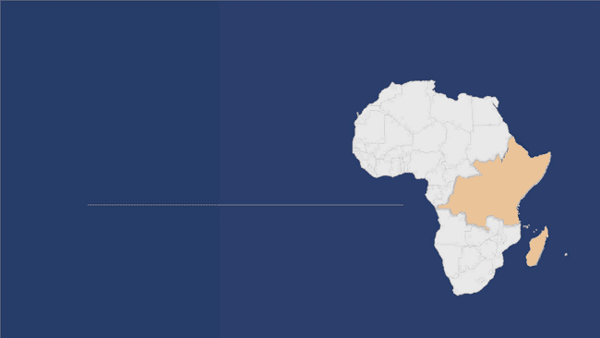
01
Setting the Scene…

Slide 3
EA weathered the pandemic better than continental &global averages
Regional GDP growth rates (2017-2023)
What Kind of Recovery
World
6.3
Africa
Eastern Africa**
to Expect?:
6.7
3.4
5.7
3.3
• U-shaped recovery?
• W-shaped Recovery?
2.8
1.7
• Or (the worst
scenario?) an inverted
shaped recovery ?
-3.0
√
2017
2018
2019
2020
2021
2022
2023
Source: National sources, UNCTAD T&D Report (2022),IMF (2022)
Note: **Weighted Average for Eastern Africa.

Slide 4
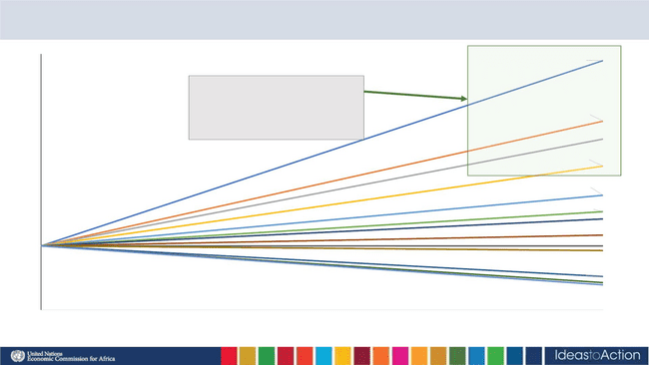
The Need to Resume High Rates of Economic Growth…
400%
350%
300%
250%
200%
150%
100%
50%
Long-term changes* in real GDP per capita for Eastern Africa: 1970-2020
Posted a strong long-run growth
performance, with more than
doubling their per capita
incomes by 2020
Uganda, 179%
Kenya, 154%
Africa, 142%
Comoros, 117%
Djibouti, 100%
Burundi, 93%
Madagascar, 52%
Somalia, 43%
DR Congo, 39%
0%
1970
2020
Source: ECA calculations from UNCTADStat data (2022)

Slide 5
Escaping Low income Status is DIFFICULT…
Source: Robertson (2022)

Slide 6
The Continent’s Growth Performance in International Perspective
Source: Mckinsey (2023)

Slide 7
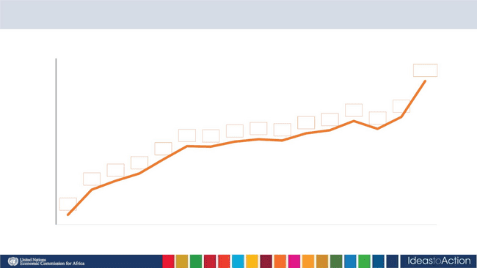
But Rwanda is heading in the right direction…
Rwanda's GDP Per Capita Growth in US dollars
1,100
1,000
900
1,004
836
797
853
784
803
800
749
759
754
730 728
700
674
615
584
600
547
500
441
400
2007 2008 2009 2010 2011 2012 2013 2014 2015 2016 2017 2018 2019 2020 2021 2022
Source: NISR (2023)

Slide 8
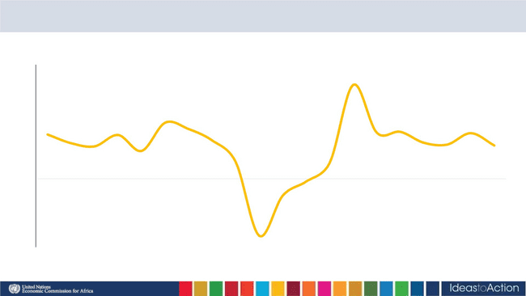
Quarterly growth rates reveal more about dynamics
Rwanda GDP Growth by Quarter, 2018-2022
20.6%
25%
20%
15%
10%
5%
12.3%
9.7%
10.9%
10.3%
10.0%
9.6%
8.4%
7.8%
7.1%
7.9%
7.5%
7.3%
6.1%
10.1%
3.7%
3.5%
-0.6%
0%
-3.7%
-5%
-10%
-15%
-12.5%
2018 2018 2018 2018 2019 2019 2019 2019 2020 2020 2020 2020 2021 2021 2021 2021 2022 2022 2022 2022
Q1 Q2 Q3 Q4 Q1 Q2 Q3 Q4 Q1 Q2 Q3 Q4 Q1 Q2 Q3 Q4 Q1 Q2 Q3 Q4
Source: National Institute of Statistics Rwanda

Slide 9
Recovery was led by a few sectors…
GDP Growth - 2020-2022
Services
25%
GDP
Industry
20%
19%
Agriculture, Forestry and Fishing
8%
0%
5%
10%
15%
20%
25%
30%

Slide 10
A Lack of Structural Transformation Underpins Slow Progress…
Source: Mangeni and Mold (2023 – forthcoming)

Slide 11
A Lack of Structural Transformation Underpins Slow Progress…
Source: Mangeni and Mold (2023 – forthcoming)

Slide 12
02
Three challenges where
the solutions are
principally regional…

Slide 13
The Three Regional Challenges
Inflation
Debt
Climate change

Slide 14
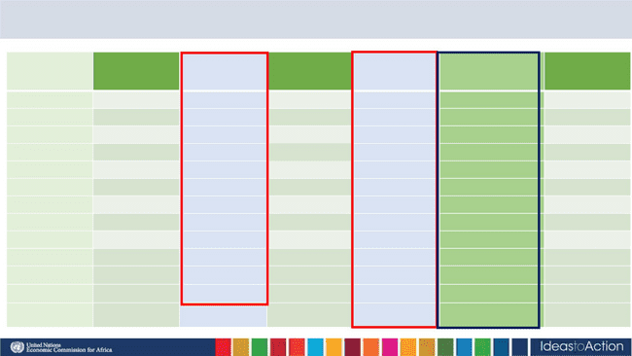
Some regional economies now suffering double-digit inflation…
Annual Headline Inflation Rate (%),in selected Eastern Africa countries
Period
Burundi
Ethiopia
Kenya
Rwanda
Seychelles
Uganda
22-Apr
16.1
31.7
6.5
7.1
7.9
8.3
8.5
9.2
9.6
9.5
9.1
9.0
9.2
9.2
7.9
10.5
2.2
4.9
22-May
22-Jun
22-Jul
18.6
17.5
19.1
19.6
20.9
22.1
26.9
26.7
28.6
28
33.1
33.8
34.3
34.5
34.0
33.8
34.0
33.9
33.9
32.0
34.2
14.8
16.1
19.6
20.4
23.9
31.0
33.8
31.7
31.1
30.3
31.0
2.1
2.1
2.3
2.8
3.0
2.9
2.6
2.5
2.4
1.1
0.9
6.3
6.8
7.9
22-Aug
22-Sep
22-Oct
22-Nov
22-Dec
23-Jan
23-Feb
23-Mar
23-Apr
9.0
10.0
10.7
10.6
10.2
10.4
9.2
9.0
28.4
0.6
8.0
Source: National Sources

Slide 15
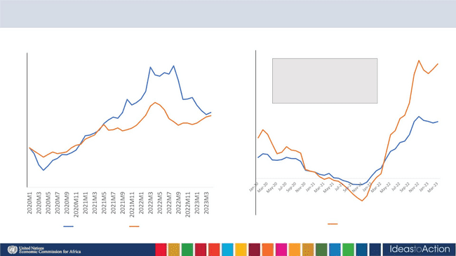
Inflationary Pressures being driven by one sector?
Commodity and Food Price Index
Monthly Inflation - All Rwanda (Jan-2020-Mar-2023
70.0%
60.0%
50.0%
40.0%
30.0%
20.0%
10.0%
0.0%
210.0
190.0
170.0
150.0
130.0
110.0
90.0
In Rwanda, food constitutes
48 and 27 percent of
weighting in rural and
urban CPI, respectively
70.0
50.0
-10.0%
-20.0%
All Commodities
Food
Food Prices
Source: UNECA using IMF Commodity Price Indexes (2022), rebased to Jan 2020
Source: NISR (April 2023)

Slide 16
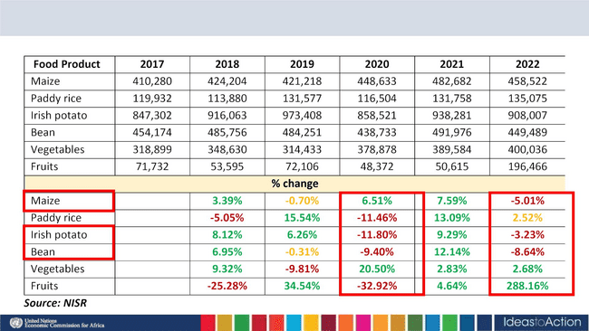
The Rains Are Failing…
Food Production Figures, 2017-2022
From: Consultant’s Report for MINAGRI, UNECA, March 2023

Slide 17
And hence there is rising dependence on food imports
Rwanda Food Imports 2014-2022 Millions USD
900
800
700
600
500
400
300
200
100
0
2014
2015
2016
2017
2018
2019
2020

Slide 18
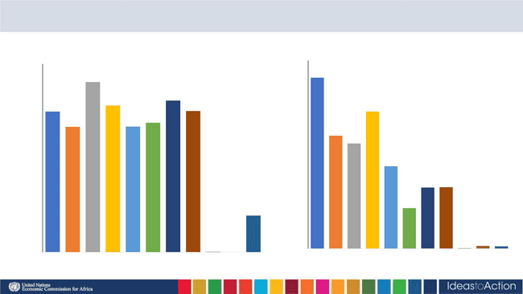
But not from where you might expect…
Imports from Uganda
12.0
10.0
8.0
6.0
4.0
2.0
-
Imports from Burundi
300.0
250.0
200.0
150.0
100.0
50.0
-
10.9
271.2
233.5
241.7
224.1
225.1
8.7
199.8
200.2
206.2
7.2
6.7
5.2
3.9 3.9
2.6
58.3
0.2 0.1
2012 2013 2014 2015 2016 2017 2018 2019 2020 2021 2022
0.6 0.2
0.0
2012 2013 2014 2015 2016 2017 2018 2019 2020 2021 2022
Source: NISR (2023)

Slide 19
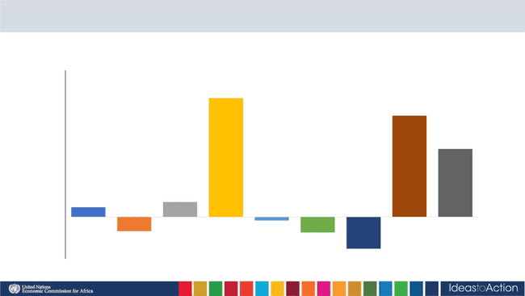
And export performance is too volatile…
Rwanda Formal Sector Goods Export Growth, 2014-2022
70%
60%
56.8%
48.4%
50%
40%
32.5%
30%
20%
10% 4.7%
0%
7.1%
-1.7%
-10%
-6.8%
-7.4%
-20%
-15.2%
2020
Source: BNR (2023).
2014
2015
2016
2017
2018
2019
2021
2022

Slide 20
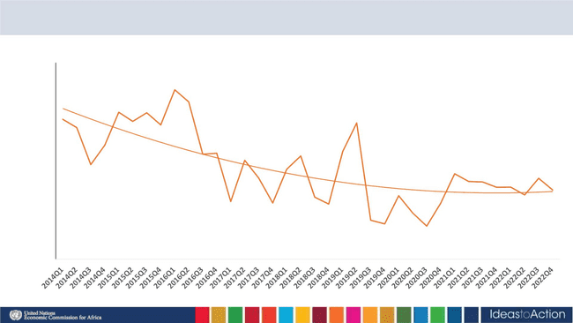
Rwanda’s Share of Domestic Exports to African Market has been Declining…
Share of Domestic Exports to Africa, 2012Q1-2022Q4
60
50
40
30
20
10
0
Source: Elaborated from NISR (April 2023)

Slide 21
Which region has the highest intra-African trade?
Intra-African Trade as % of Total Trade, 2019-2021 average
30%
25%
20%
15%
10%
5%
Eastern Africa
Southern Africa
Central Africa
Africa
Western Africa
Northern Africa
0%
0%
5%
10%
25%
Intra-African Exports as % of Total Exports
15%
20%
30%
35%
40%
Source: ECA analysis of UNCTADStat Data (2022)

Slide 22
Crisis? What Crisis?…
EAC Intra-Regional Exports - 2022-2023
(billions USD)
EAC Intra-Regional Exports as % of Total,
2014-2022
6.0
5.0
4.0
3.0
2.0
1.0
0.0
5.2
24.3%
4.2
21.9%
19.8%
20.2%
19.9%
18.7%
18.2%
3.3
3.4
17.6%
2.9
3.0
3.0
15.1%
2.8
2.8
Source: Calculated from IMF DoTs (June 2023)

Slide 23
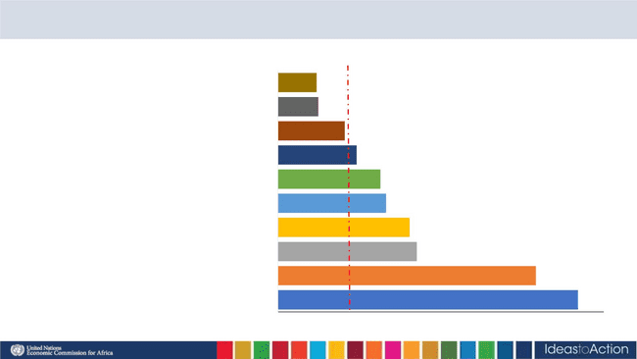
African Market is already the Major Destination of more Sophisticated Exports…
African Exports, Regional Orientation Index 2021
Medium technology manufactures: automotive
Primary products
0.5
0.6
Low technology manufactures: textile, garment and footwear
Resource-based manufactures: other
0.9
1.1
High technology manufactures: other
1.4
1.5
High technology manufactures: electronic and electrical
Medium technology manufactures: process
Medium technology manufactures: engineering
Resource-based manufactures: agro-based
Low technology manufactures: other products
1.8
1.9
3.6
4.1
Source: Calculated using the Lall (2000) classification
from UNCTADStat data
0.0
0.5
1.0
1.5
2.0
2.5
3.0
3.5
4.0
4.5

Slide 24
03
Regional Approaches
to Debt

Slide 25
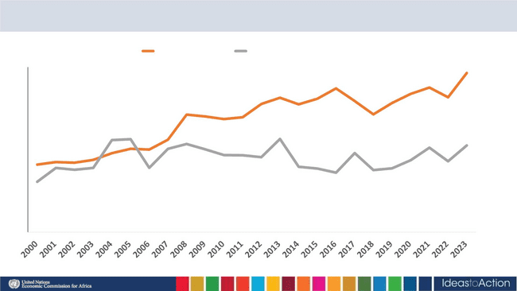
Resource Gap has been growing…
Total investment Gross national savings
30
25
20
15
10
5
0
Source: IMF World Economic Outlook dataset - *Estimates from 2022

Slide 26
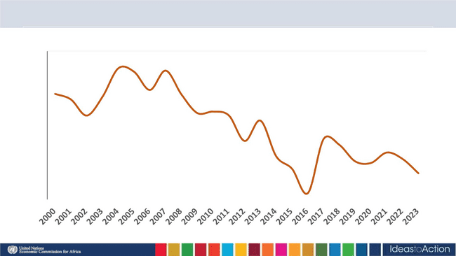
Trade Deficits have been rising and the Current Account Deteriorating…
Current Account Balance 2000-2023 % of GDP
0
-2
-4
-6
-8
-10
-12
-14
-16
Source: IMF (2023).

Slide 27
Fiscal deficits and debt levels are high in the region…
Debt and Fiscal Balance (IMF Estimates April 2023)
80
70
60
50
40
30
20
10
0
Kenya
Djibouti
Rwanda
Seychelles
Ethiopia
Tanzania
Burundi
Madagascar
Uganda
Comoros
DRC
-8
-7
-6
-5
Fiscal Deficit to GDP
-4
-3
-2
Source: UNECA using IMF (2023)

Slide 28
Composition of Debt Matters for its Sustainability…
Interest Payments on Debt as % of Government Revenue, 2015-2021
Rwanda
Uganda
Kenya
Sources of Finance as % of Regional GDP
25
20
15
10
5
22.2
17.9
12.3
10.7
5.5
2.9
0
2015 2016
Source: World Bank Development Indicators 2023
2017
2018
2019
2020
2021

Slide 29
04
Climate Change

Slide 30
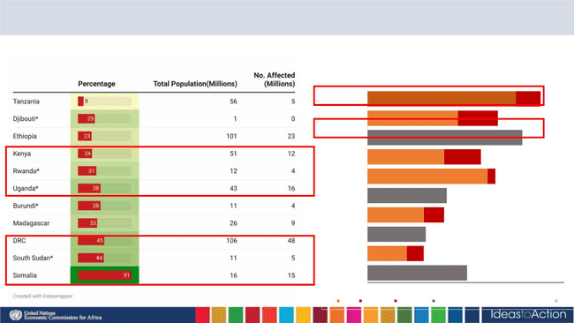
Food insecurity mounting in the region
Prevalence of insufficient food consumption(as of June 2023)
Top Ten countries with highest number of people in food crisis in
world, 2022(Millions)
D.R Congo
Afghanistan
Ethiopia
Yemen
22.6
3.8
13.8
6.1
23.6
11.7
5.6
0.03
Nigeria
18.3
1.2
Syrian
12.1
Sudan
8.6
3.1
Ukraine
Pakistan
Myanmar
8.9
6
2.6
15.2
Note:*Predicted figure
Source:WFP Hunger Map,2023
0
5
10
15
20
25
30
3- Crisis 4- Emergency 5- Catastrophe Non IPC/CH moderate + severe acute food insecurity
Source: FSIN (2023), UNECA calculations.

Slide 31
Exacerbated by Climate Change…
Number of Climate Disasters in Eastern Africa, 2021 – 2023
Droughts Floods Storms
Uganda
Rwanda
DRC
Somalia
Kenya
Ethiopia
Tanzania
Djibouti
South Sudan
Burundi
Madagascar
0
2
4
6
Number of climate disasters
8
10
12
Source: CRED,2023

Slide 32
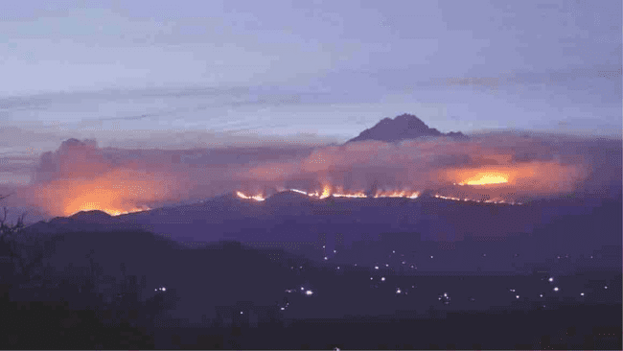
Photo | Thomas Becker | Picture Alliance Via Getty Images/East African Newspaper

Slide 33
Conclusions…
•Some major challenges confronting Rwanda are regional in
nature
•In many cases (though not all), regional solutions are
required
•Example of collective negotiations to reform the Special
Drawing Rights
•Example of climate financing
•Example of AfCFTA - we either move together or don’t
move at all

